Slide 1

Job Search App
Aditi (BE/15086/17), CSE
Salvi Verma (BE/15048/17), CSE

Slide 2
CONTENTS
OBJECTIVE
INTRODUCTION
TECHNOLOGIES USED
WHY ANGULAR ?
WHY SPRING BOOT ?
FLOW CHART
SCREENSHOTS
REFERENCE
THANK YOU NOTE

Slide 3
OBJECTIVE
The main objective is to make a common webapp that would help any person find a job in any field easily.
The application offers anonymous contribution of the vacancy of post in a specific company.
It is thrown open to a very wide base of job seekers.
It also caters the security of the credentials of the registered users.

Slide 4
INTRODUCTION
This webapp has some filters for searching any job.
Some of the filters include Job Profile, company name( eg : Software developer, Data engineer ).
It is open to everyone. Any person can add jobs in this webapp.

Slide 5
TECHNOLOGIES USED
Programming language : JAVA
Angular is used for frontend.
Spring Boot is used for backend.
Queries are written using SQL.
InMemory h2 database has been used.

Slide 6
WHY ANGULAR ?
Angular is an open-source front-end framework developed by Google for creating dynamic, modern web apps.
Feature of angular:
TypeScript
POJO
Modular Structure
Code Consistency

Slide 7
WHY ANGULAR ?
Simplified Unit-Testing
Reusability
Improved Readability
Ease of Maintenance

Slide 8
WHY SPRING BOOT ?
Spring is a very popular Java-based framework for building web and enterprise applications.
Features of Spring Boot:
Easy dependency Management
Auto Configuration
Embedded Servlet Container Support
Easy to use but powerful database transaction management capabilities

Slide 9
SPRING BOOT FLOW ARCHITECTURE
Repository class extending CRUD Services
Dependency Injection
Client
HTTP
Requests
Controller
Service layer
Model
JPA/Spring Data
Database

Slide 10
Flow chart
Have an account
Start
Enter the website
NO
Sign up
YES
Get Job or post Job
Login
Get Job
Post Job
Logout
End

Slide 11
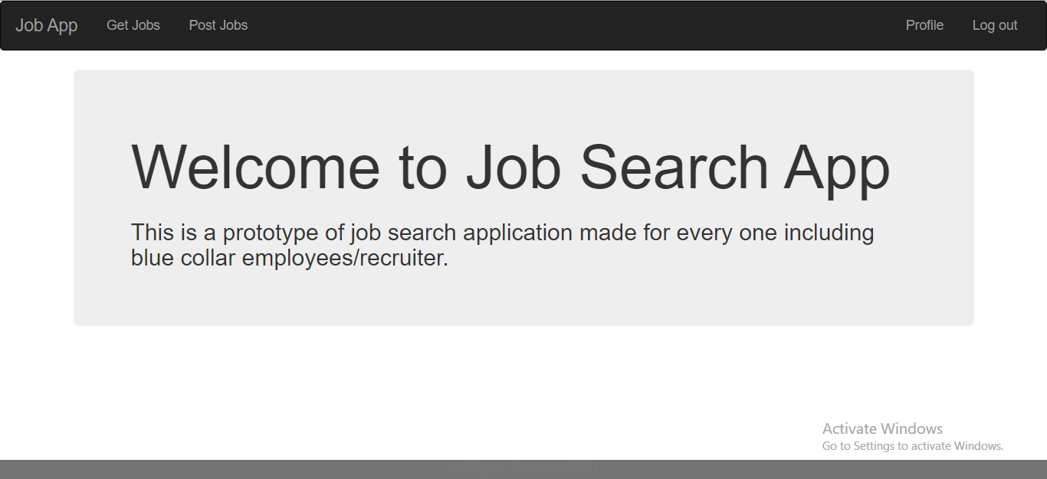
About us page

Slide 12
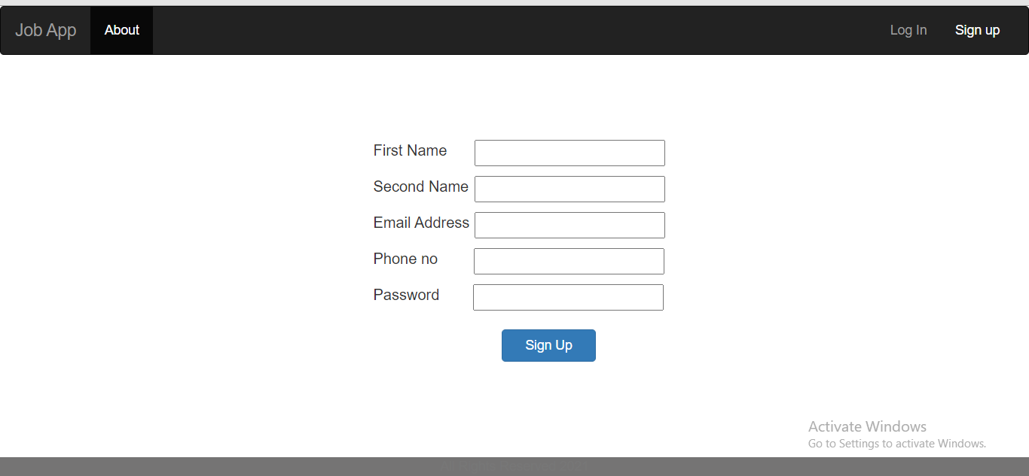
Sign Up page

Slide 13
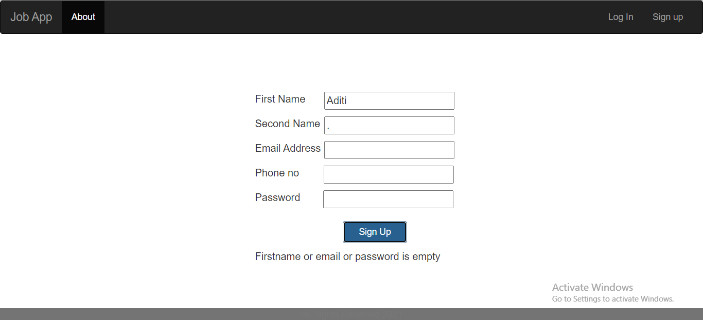
Sign Up page ( Validations )

Slide 14
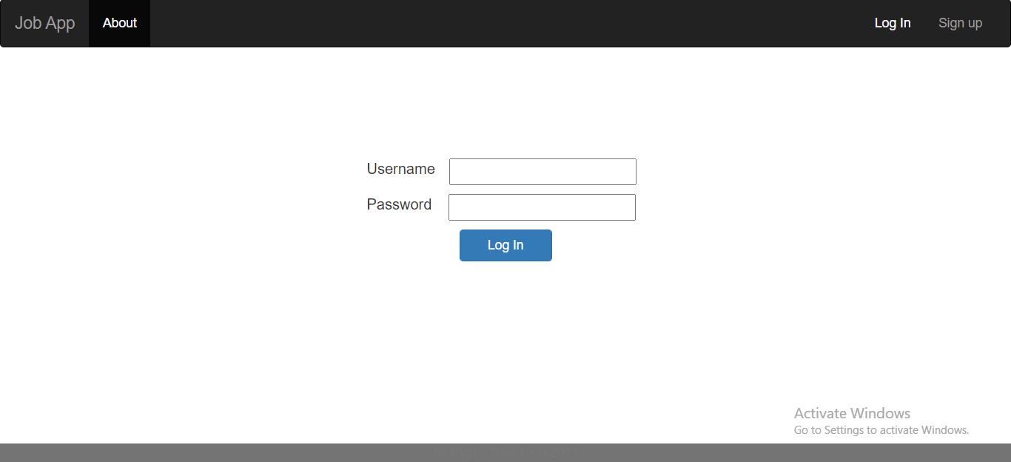
Login page

Slide 15
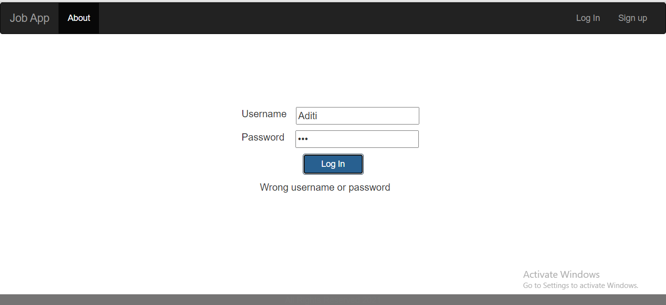
Login page ( Validations )

Slide 16
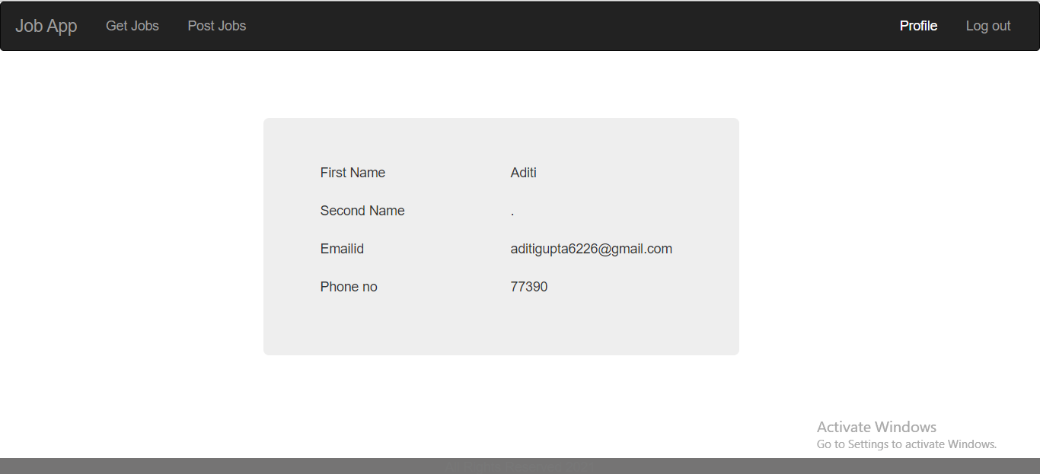
User Profile page

Slide 17
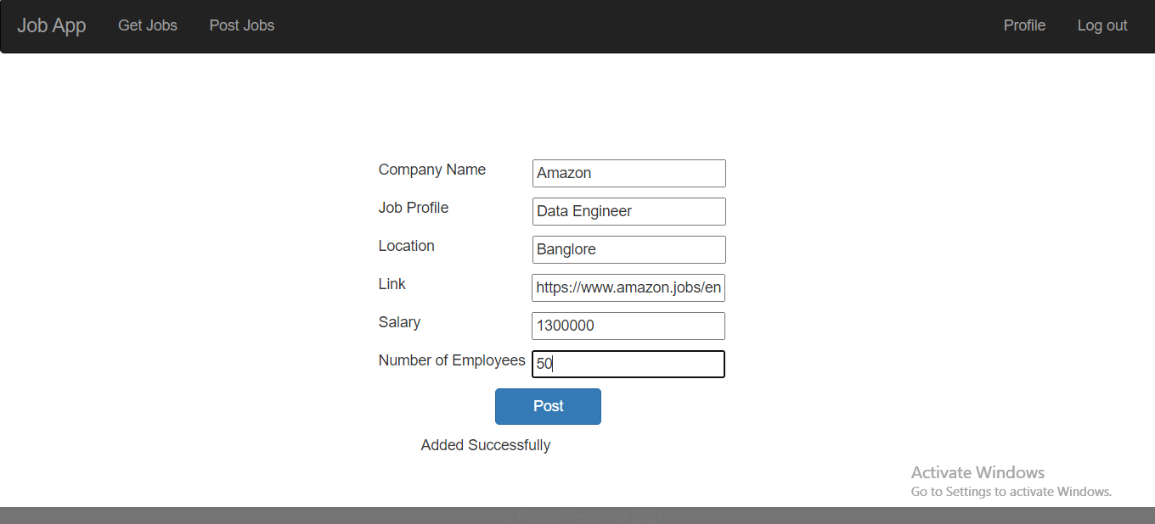
Post Job page

Slide 18
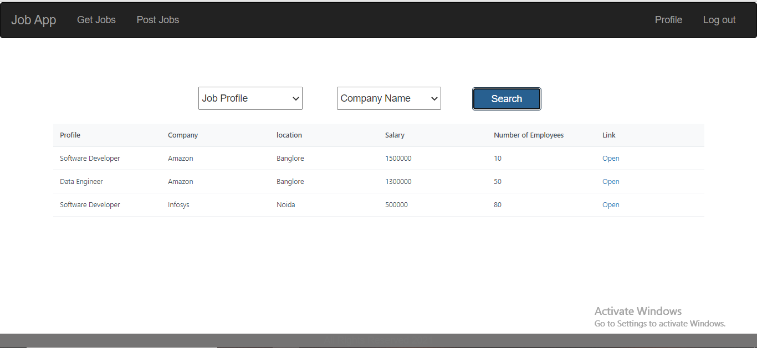
Get Job page (Without any filter)

Slide 19

Get Job Page(With Profile as filter)

Slide 20
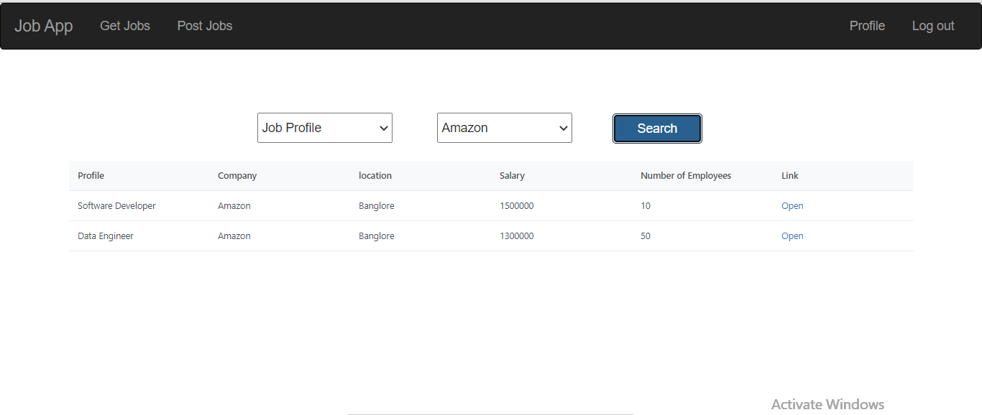
Get Job Page (with Company Name as filter)

Slide 21

Get Job Page ( With Profile and Company Name as filter)

Slide 22
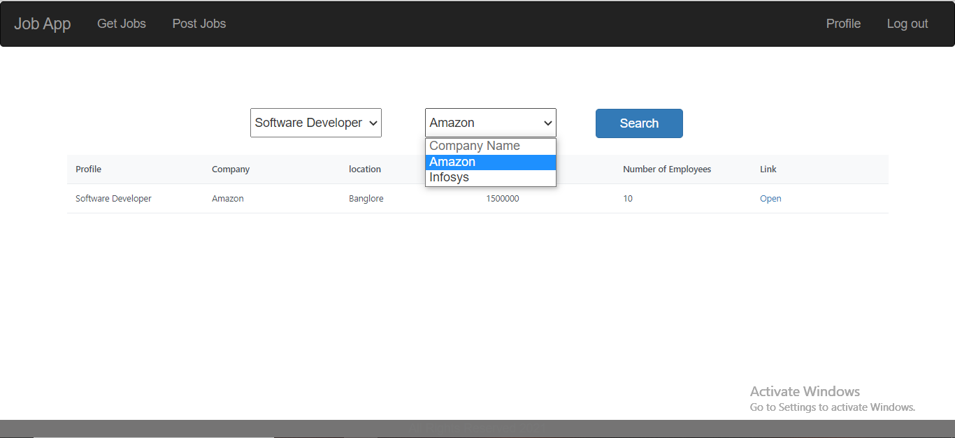
Drop Down(Company Name)

Slide 23
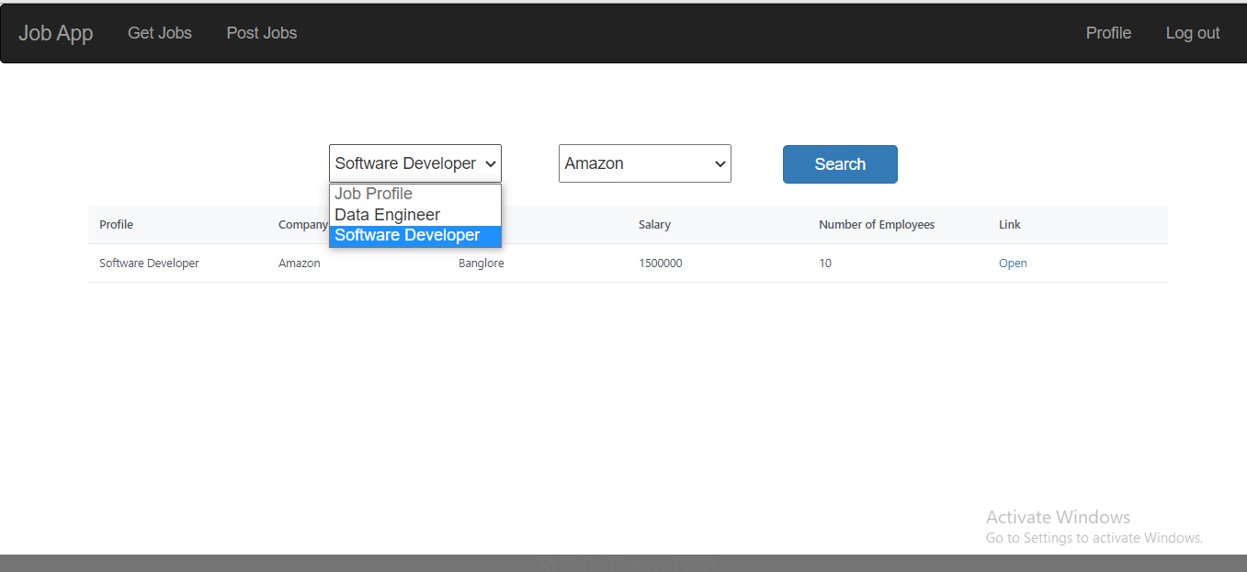
Drop Down(Job Profile)

Slide 24
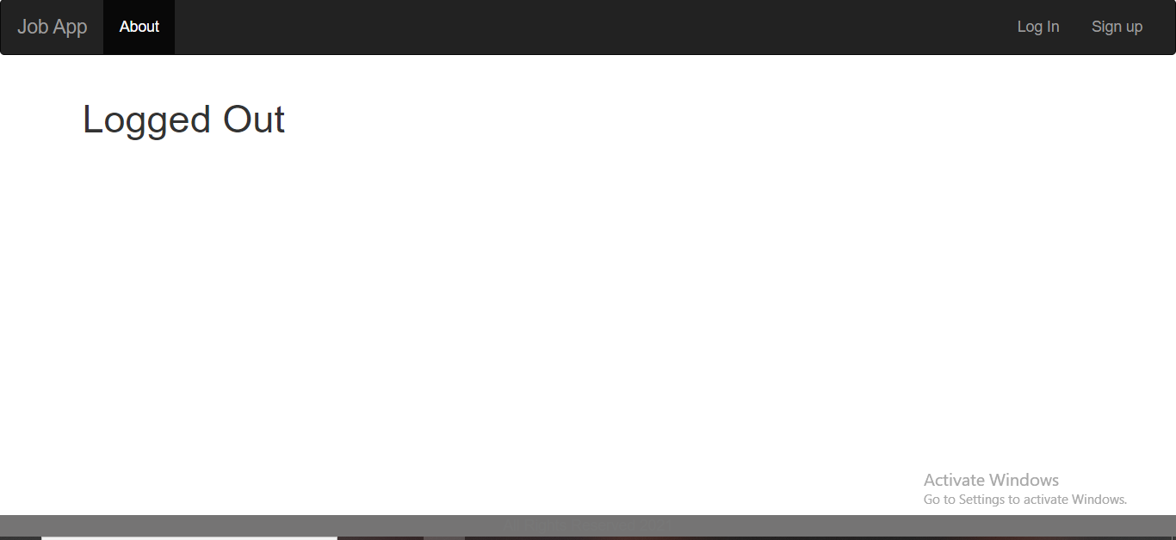
Log out page

Slide 25
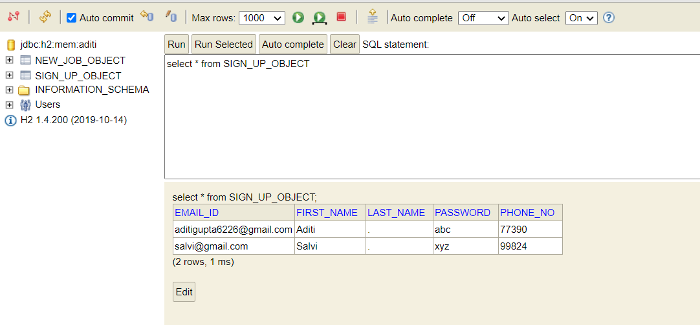
Database structure (Signup object)

Slide 26
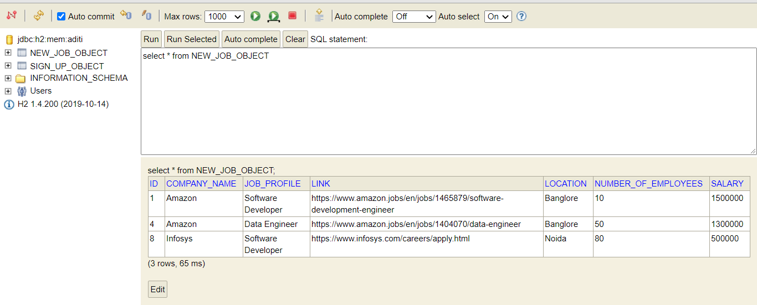
Database structure (New job object)

Slide 27
REFERENCES:
https://angel.co/
https://www.firstnaukri.com/
https://www.primefaces.org/primeng/
https://www.udemy.com/course/full-stack-application-development-with-spring-boot-and-angular/
https://docs.spring.io/spring-boot/docs/current/reference/htmlsingle/

Slide 28
CONCLUSION
This webapp will help everyone to get a job easily and conveniently.
As any person can add job, we will have a large number of jobs from all sectors easily.

Slide 29
THANK YOU!

